Slide 1
“
Who will eat Pizza
In Do-Bong Gu
”
Latest Technique Project

Slide 2
INDEX
목차
Project Synopsis
System Design
Implementation
Optimization
Demonstration
Motivation
Blueprint
Data acquisition
Bar chart
Video
Project Role
Using program
Data Preprocess
Block Map
Data Storage
Data Analysis

Slide 3
Project Synopsis

Slide 4



Synopsis
Motivation
How to attract customer?
Who is potential customer?
Notes:
Rate of closure of the restaurant industry

Slide 5
Synopsis
Motivation
We need …
Market Analysis
&
Current Consumption Pattern Analysis
Notes:
Rate of closure of the restaurant industry

Slide 6

Synopsis
Motivation
Market Analysis
We focused Seoul.
->look for the characteristics of Seoul area.
Ex) like… What are the characteristics of Gwang-jin Gu?
Notes:
Rate of closure of the restaurant industry

Slide 7
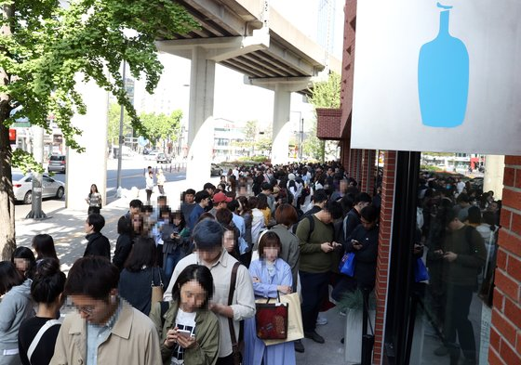
Synopsis
Motivation
Current Consumption Pattern Analysis
Ex)
Who is main customer of our pizza store?
When they usually visit?
Notes:
Rate of closure of the restaurant industry

Slide 8
Synopsis
Project Role
박해연
신기성
손장민
유유진
“
“
“
“
Project Leader
Data Acquisition Data Preprocess
Spark Processing Visualizaton (Bar chart)
Team
Data Acquisition
Data Preprocess
Spark Processing
Visualizaton (Bar chart)
Optimization
Team
Spark Processing Visualization (Chart on map)
Scrum master
Visualization (Block map) Make PPT
”
”
”
”

Slide 9
System Design

Slide 10






System Design
Blueprint
Collect data and preprocess.

Slide 11


System Design
Blueprint
Data Analysis and Visualization

Slide 12




System Design
Using Program
HDFS

Slide 13

System Design
Using Program
Why Zeppelin??
UI like
Can be using various interpreter in same time.
(Angular.js, pyspark, sql)
Support Dynamic Form

Slide 14
Implementation

Slide 15



Data Acquisition
Number of ordering phone call in Seoul_Pizza, Chicken, Chinese food(2013~2019)
Population by age, gender in Seoul (2019, the first quarter)
Store Information (2018.12)

Slide 16
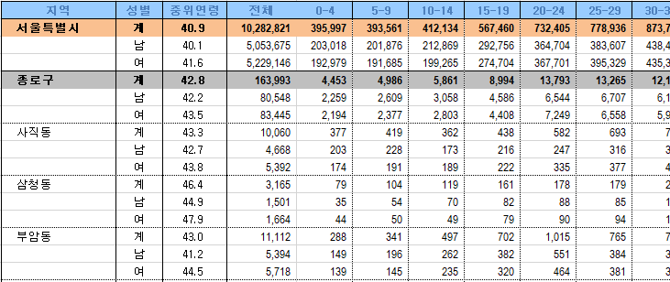
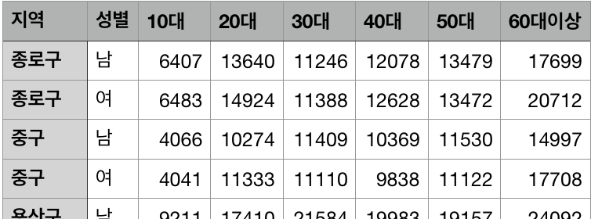
Data Preprocess
Population_age_gender_data
Extract data by Gu not Dong
Combine age range by 10

Slide 17
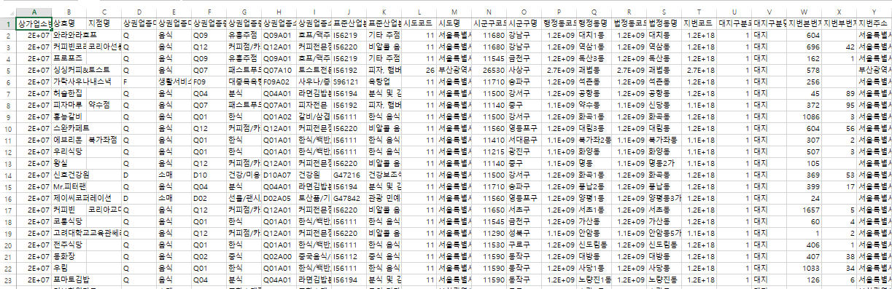
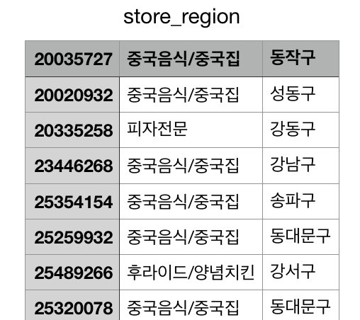
Data Preprocess
Store information
Delete unnecessary rows

Slide 18
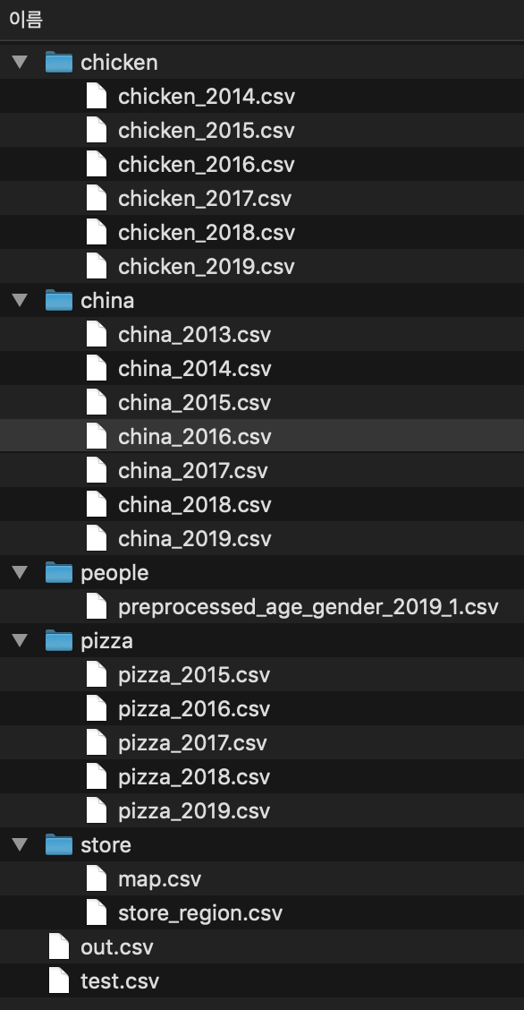

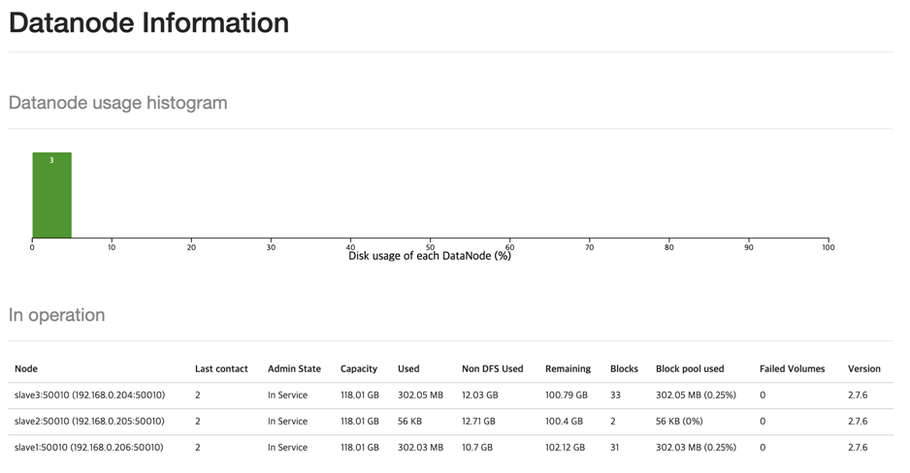
Data Storage
HDFS clustering
604MB

Slide 19
Data Analysis
Goal of Analysis
Market Analysis
Successful Marketing strategy
Current consumption pattern analysis

Slide 20
Data Analysis
Goal of Analysis
Market Analysis
Successful Marketing strategy
Define Characteristics of population by region

Slide 21
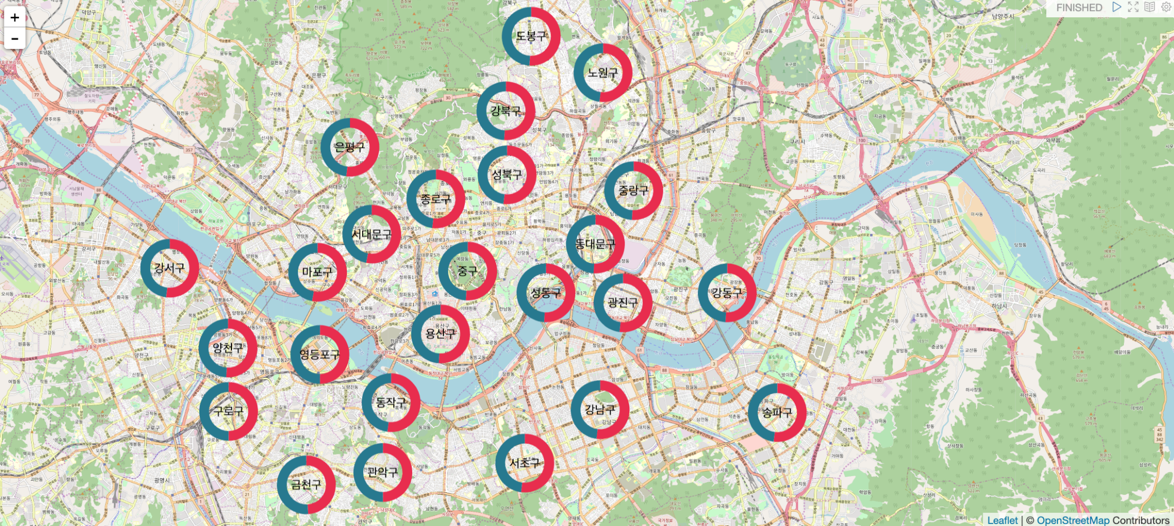
Data Analysis
Market Analysis
1) Gender Ratio => There is not a big difference

Slide 22
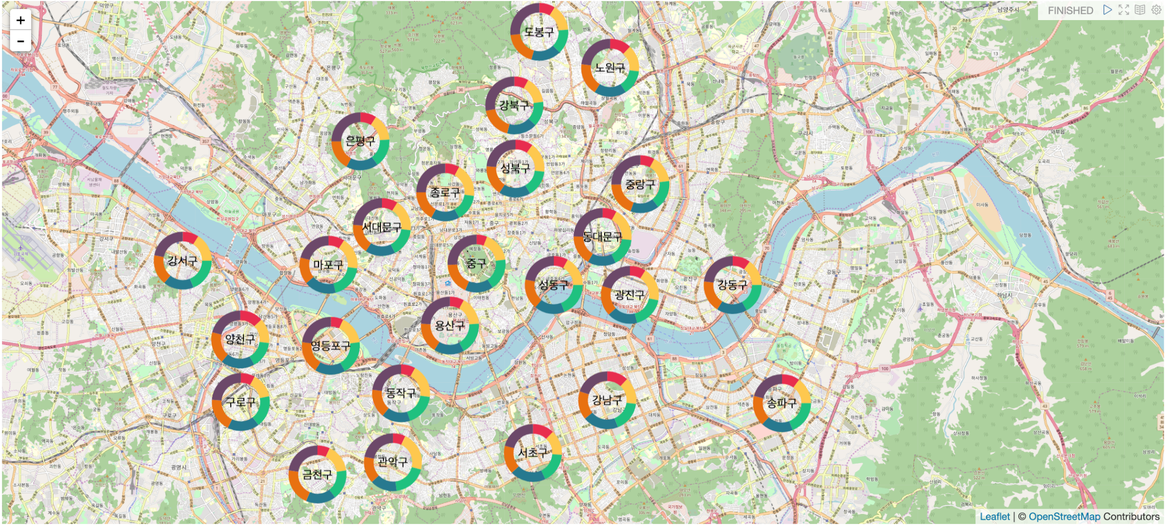
Data Analysis
Market Analysis
2) Age Ratio => There is a slight difference

Slide 23
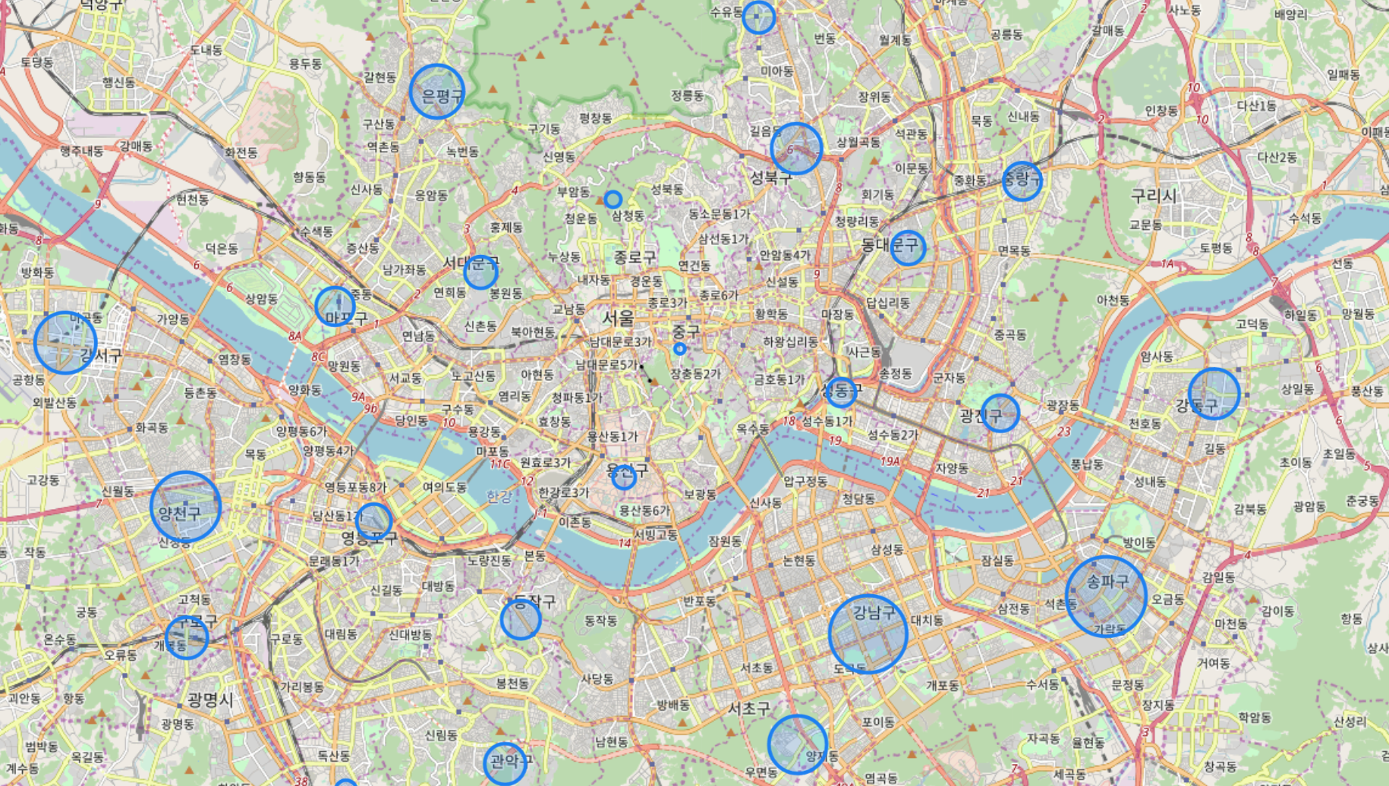
Data Analysis
Market Analysis
Regional Population by age and gender
10s Male

Slide 24
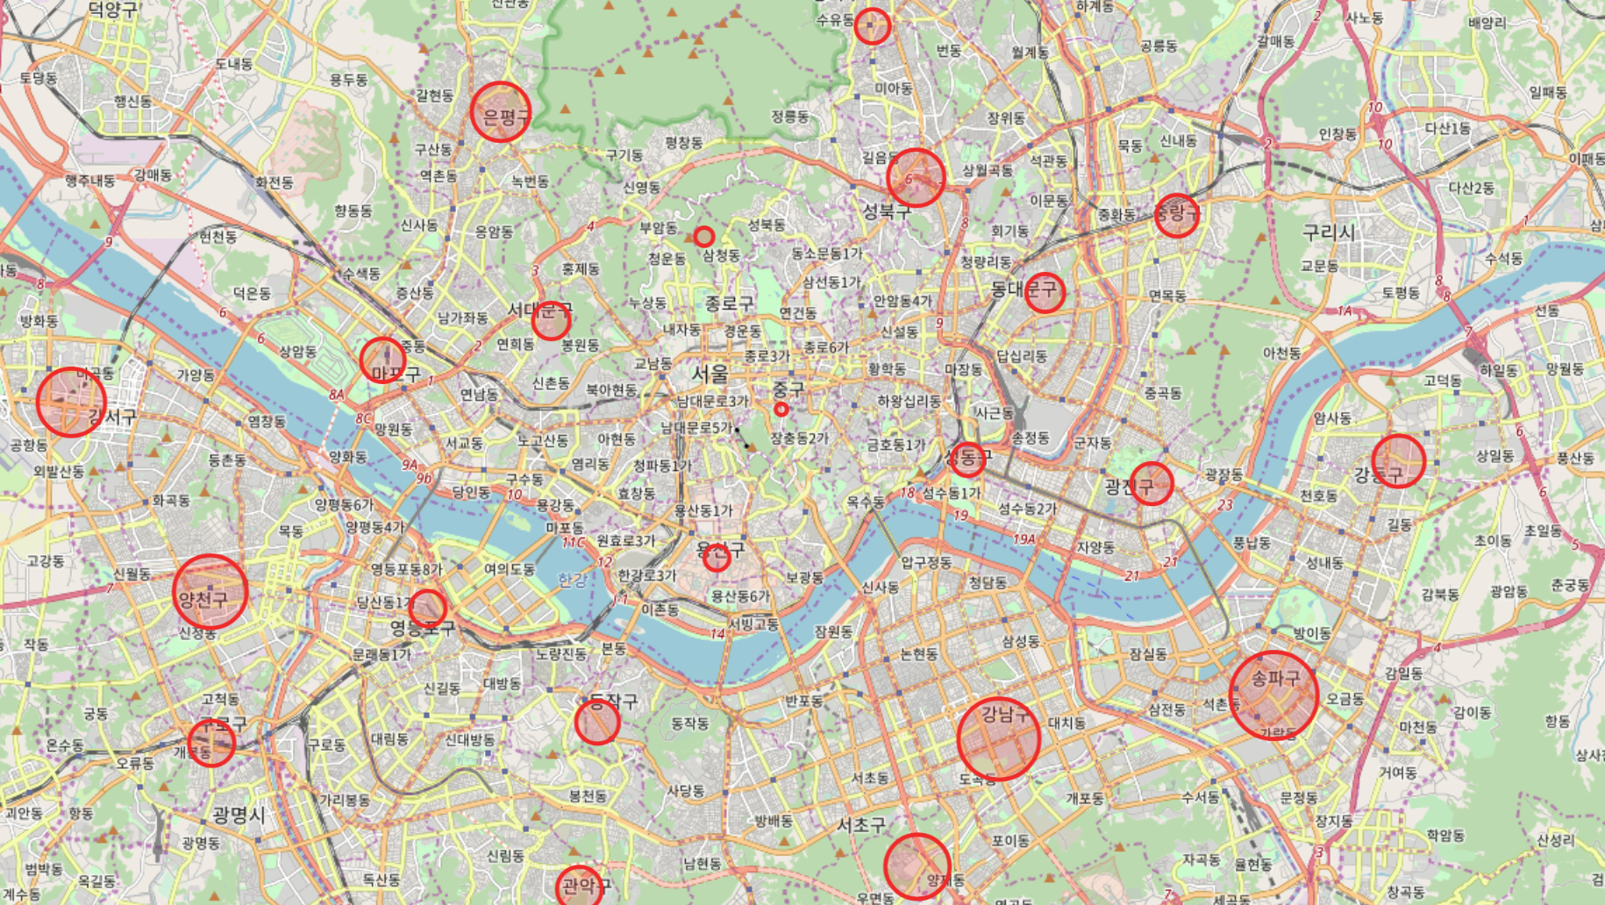
Data Analysis
Market Analysis
Regional Population by age and gender
10s Female

Slide 25
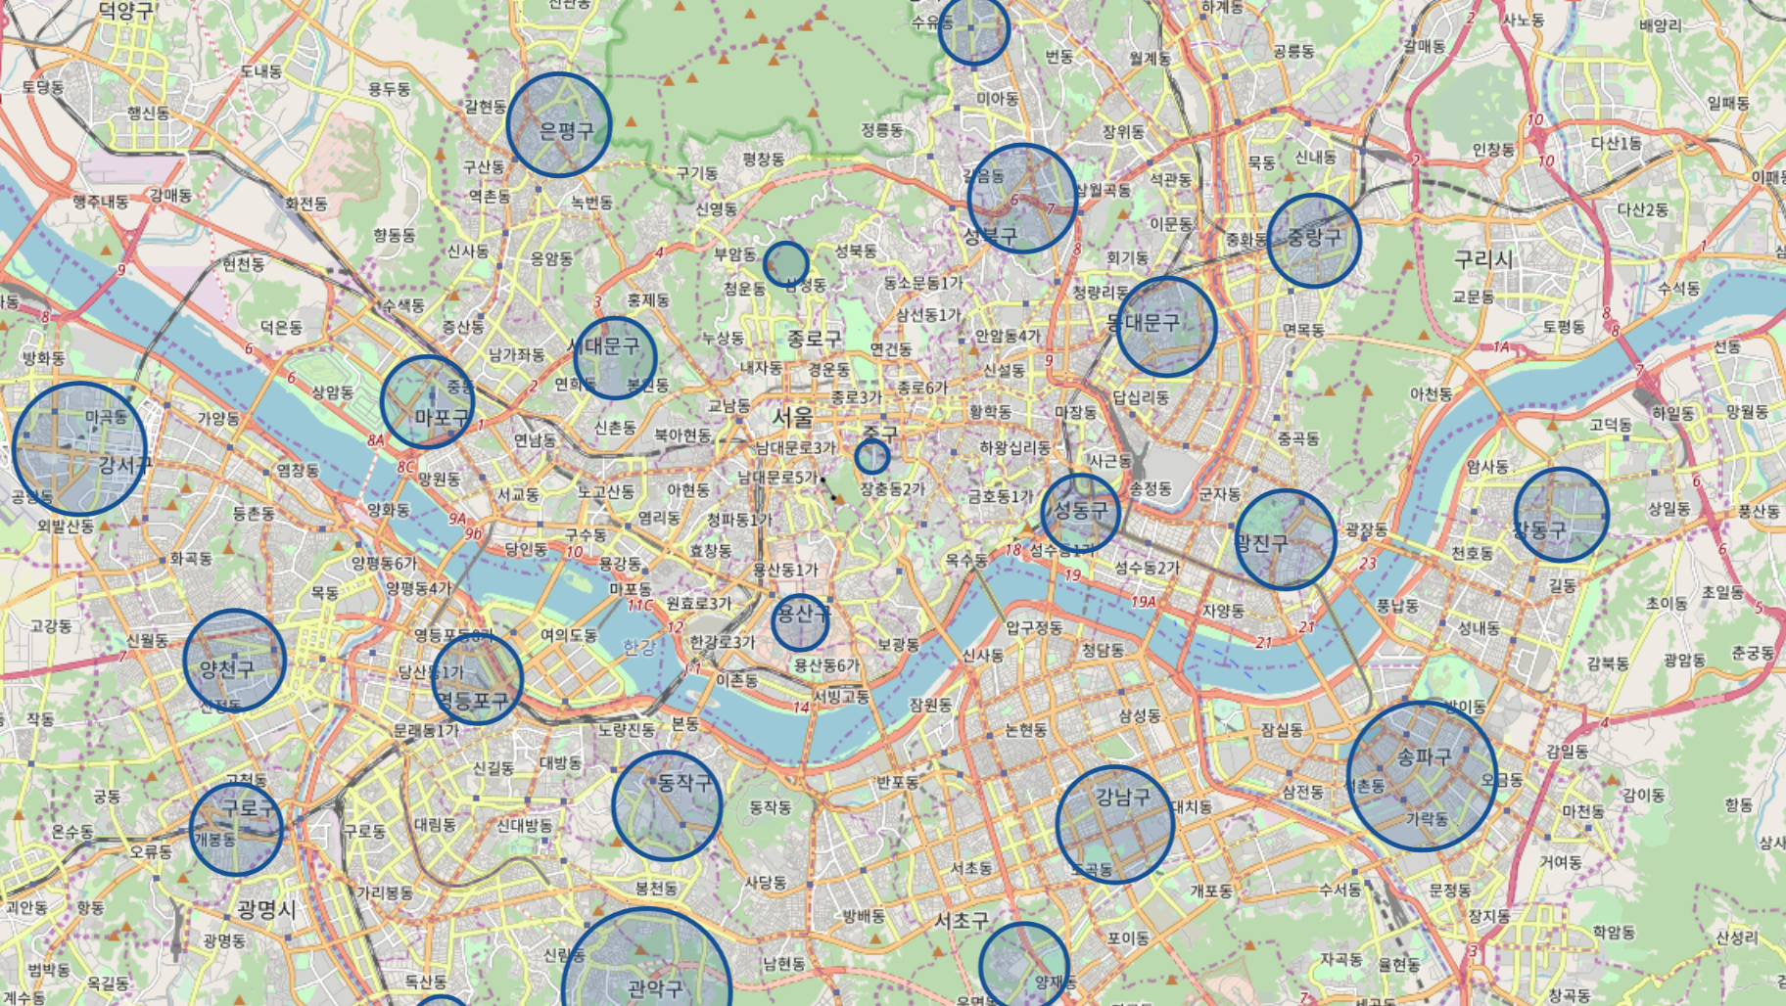
Data Analysis
Market Analysis
Regional Population by age and gender
20s Male

Slide 26
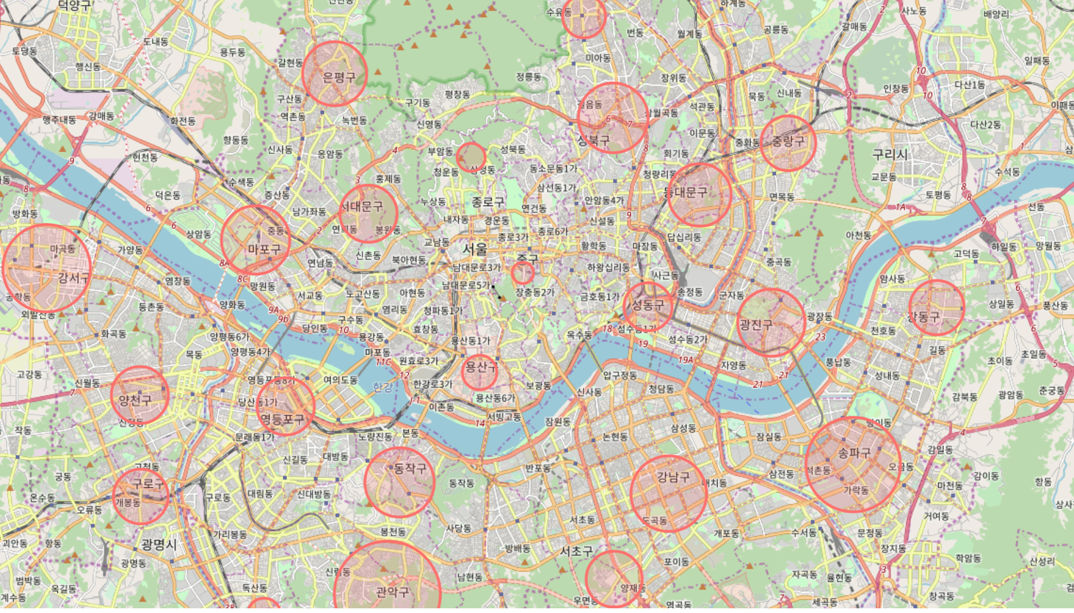
Data Analysis
Market Analysis
Regional Population by age and gender
20s Female

Slide 27
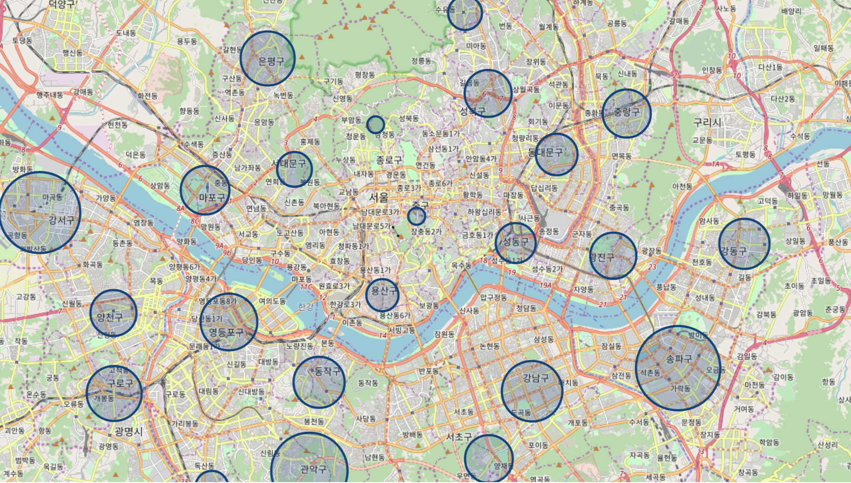
Data Analysis
Market Analysis
Regional Population by age and gender
30s Male

Slide 28
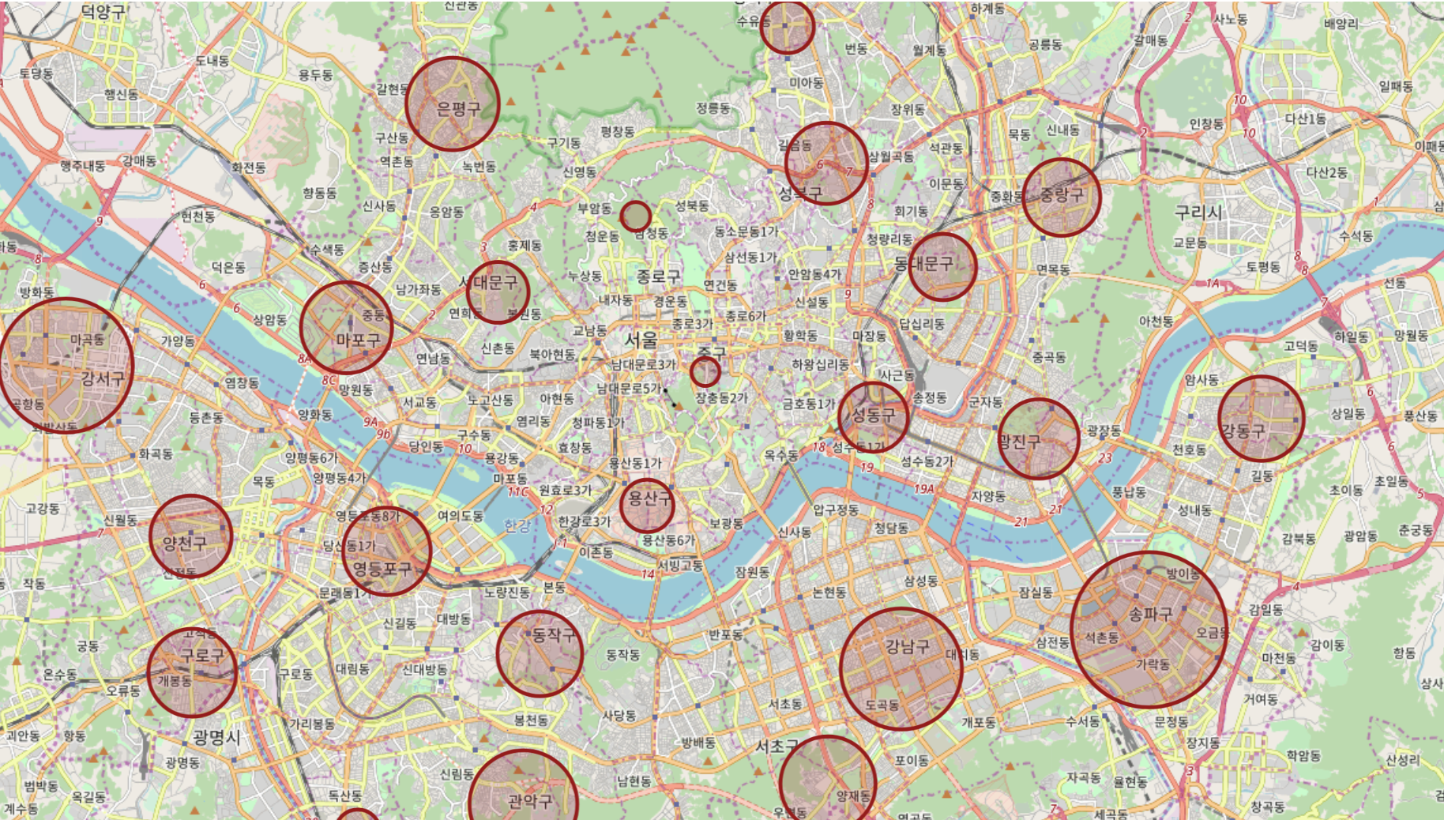
Data Analysis
Market Analysis
Regional Population by age and gender
30s Female

Slide 29
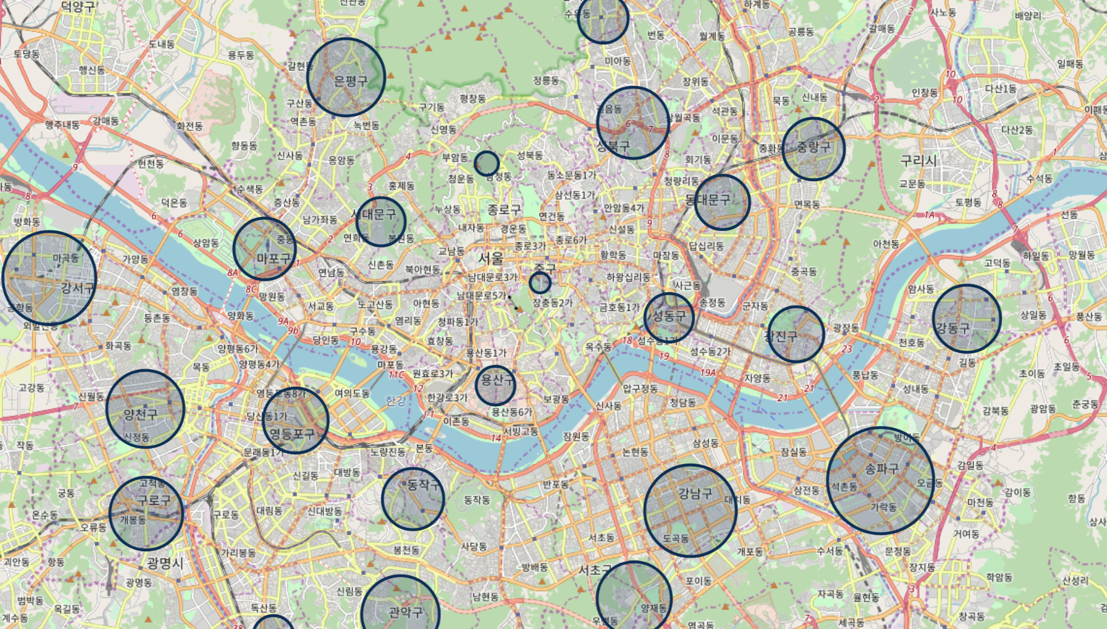
Data Analysis
Market Analysis
Regional Population by age and gender
40s Male

Slide 30
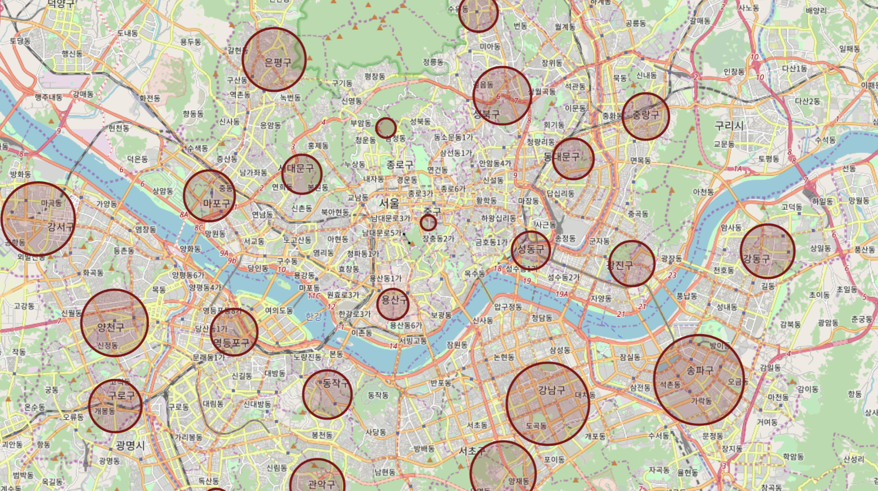
Data Analysis
Market Analysis
Regional Population by age and gender
40s Female

Slide 31

Data Analysis
Market Analysis
Regional Population by age and gender
50s Male

Slide 32
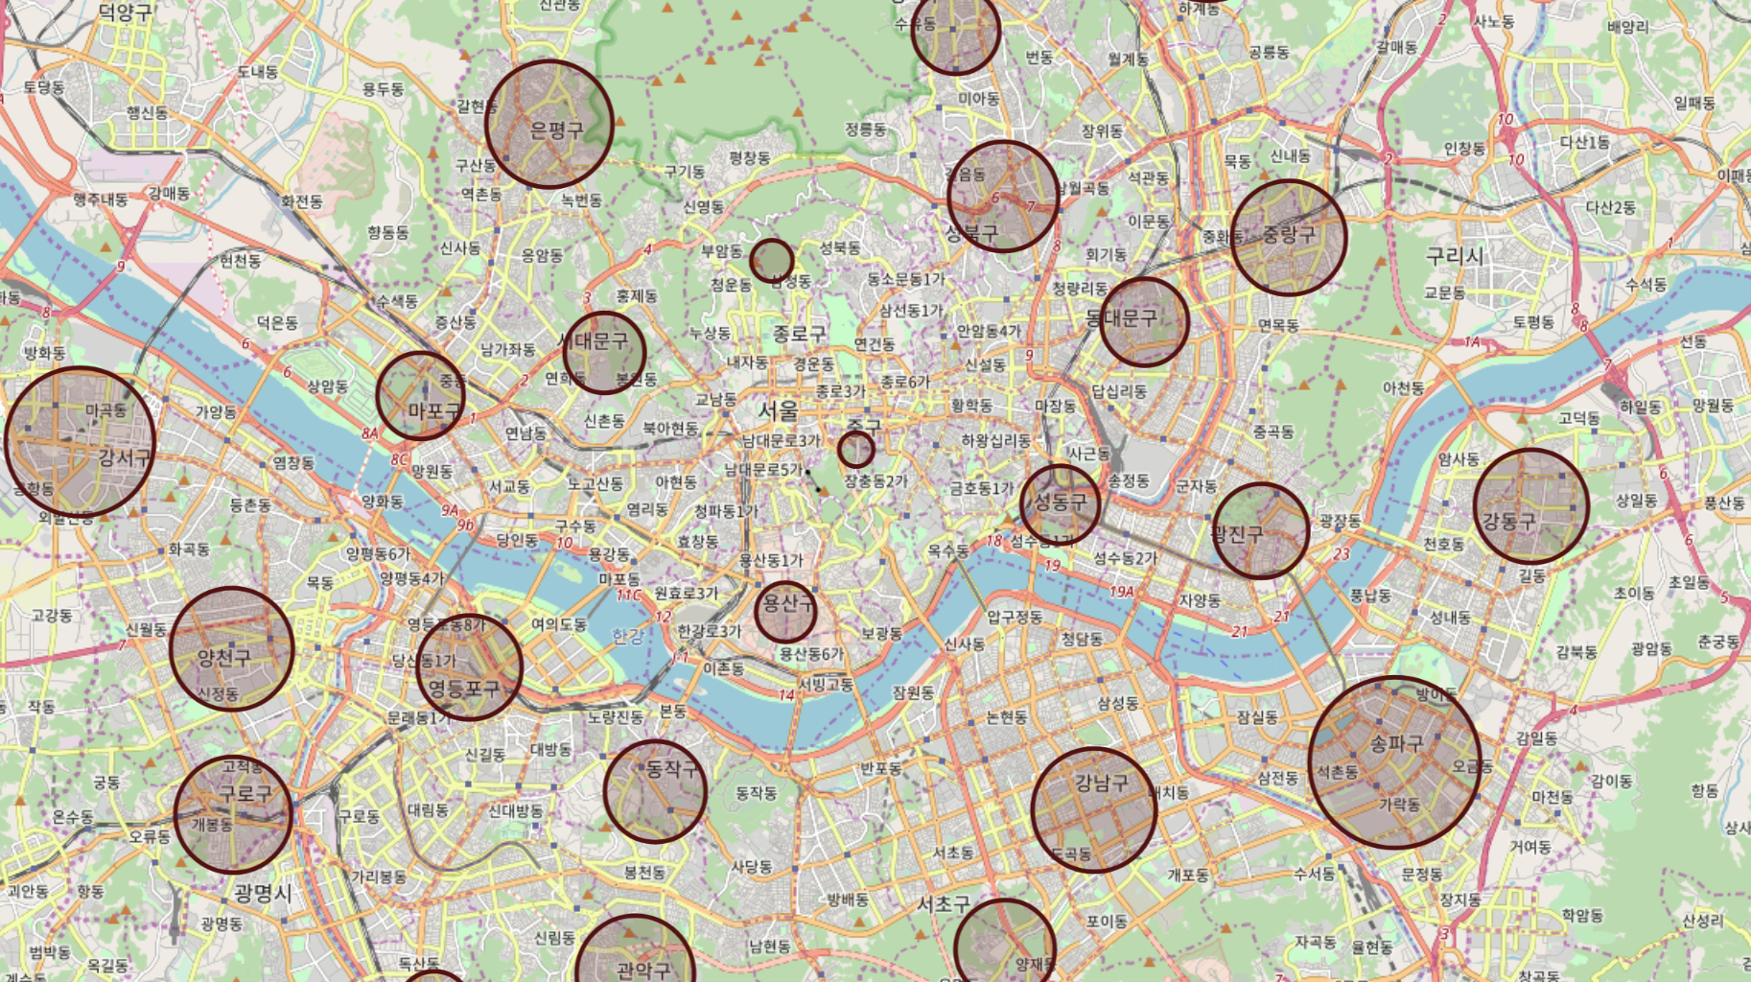
Data Analysis
Market Analysis
Regional Population by age and gender
50s Female

Slide 33
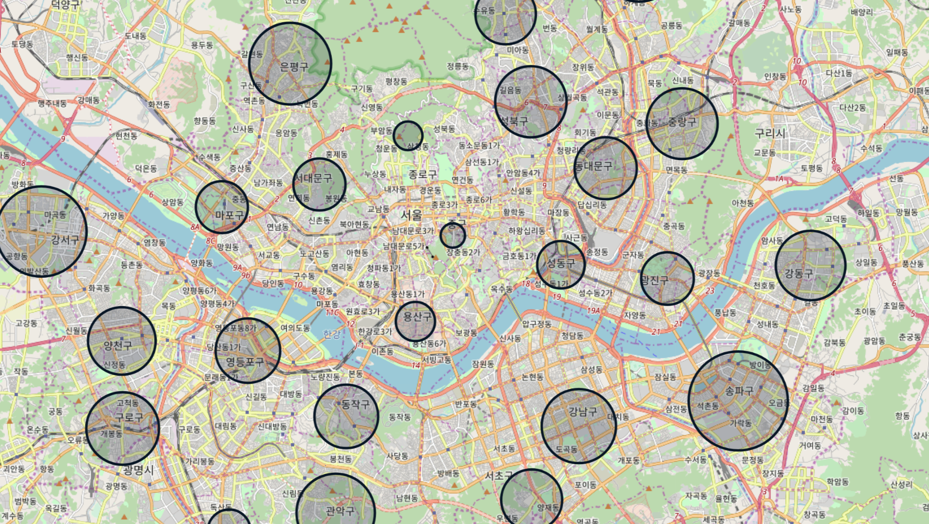
Data Analysis
Market Analysis
Regional Population by age and gender
60s Male

Slide 34
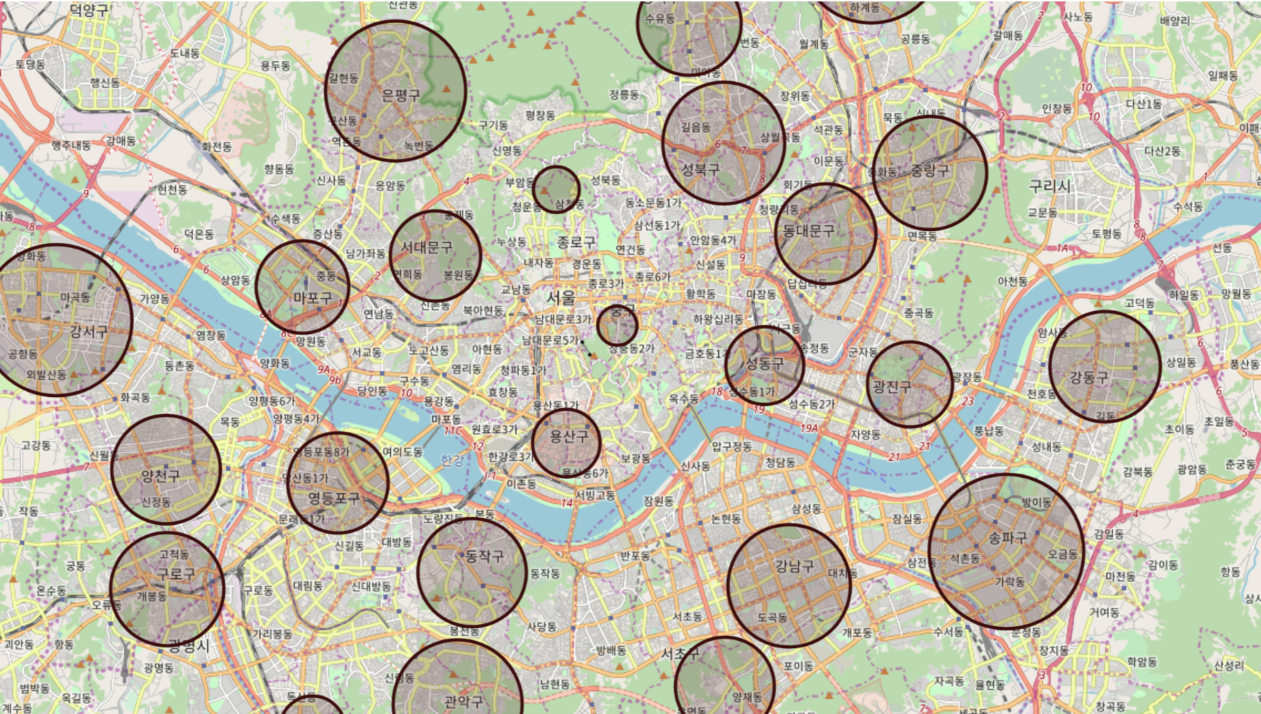
Data Analysis
Market Analysis
Regional Population by age and gender
60s Female

Slide 35
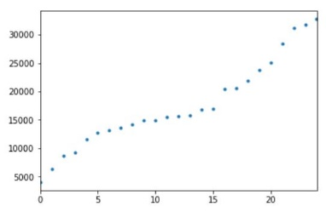
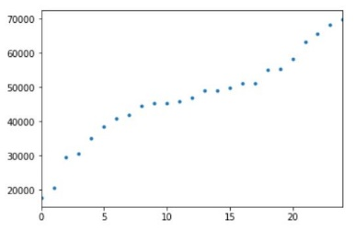
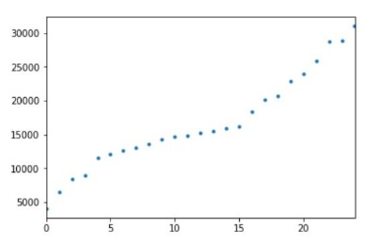
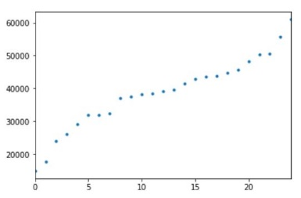
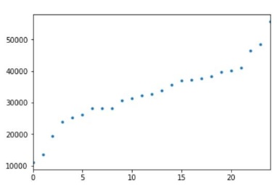
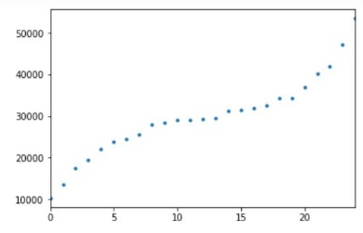
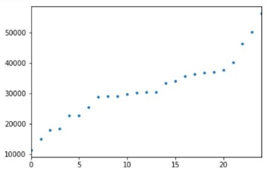
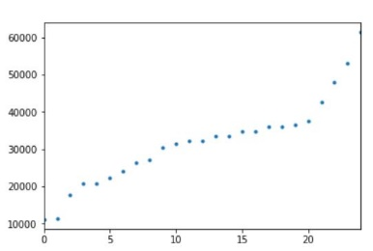
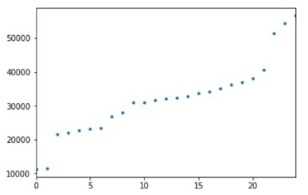
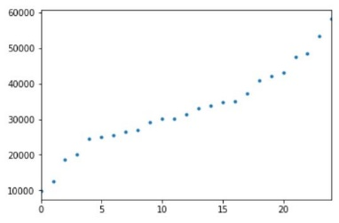
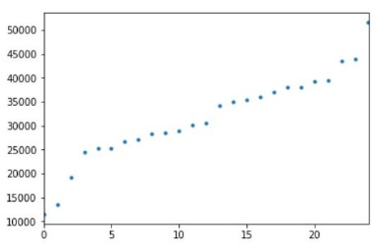
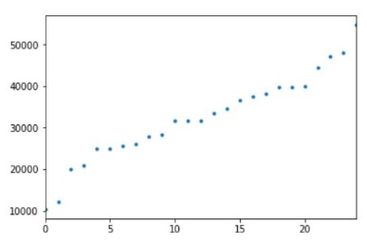
Data Analysis
Market Analysis
Regional Population by age and gender => “There is a difference “

Slide 36
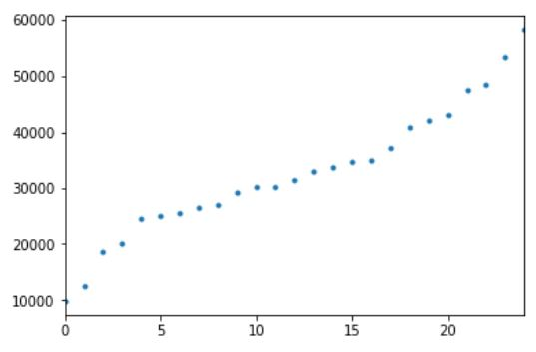
Data Analysis
Market Analysis
Linear relationship

Slide 37
Data Analysis
Market Analysis
Total 25 regions
Group five regions

Slide 38
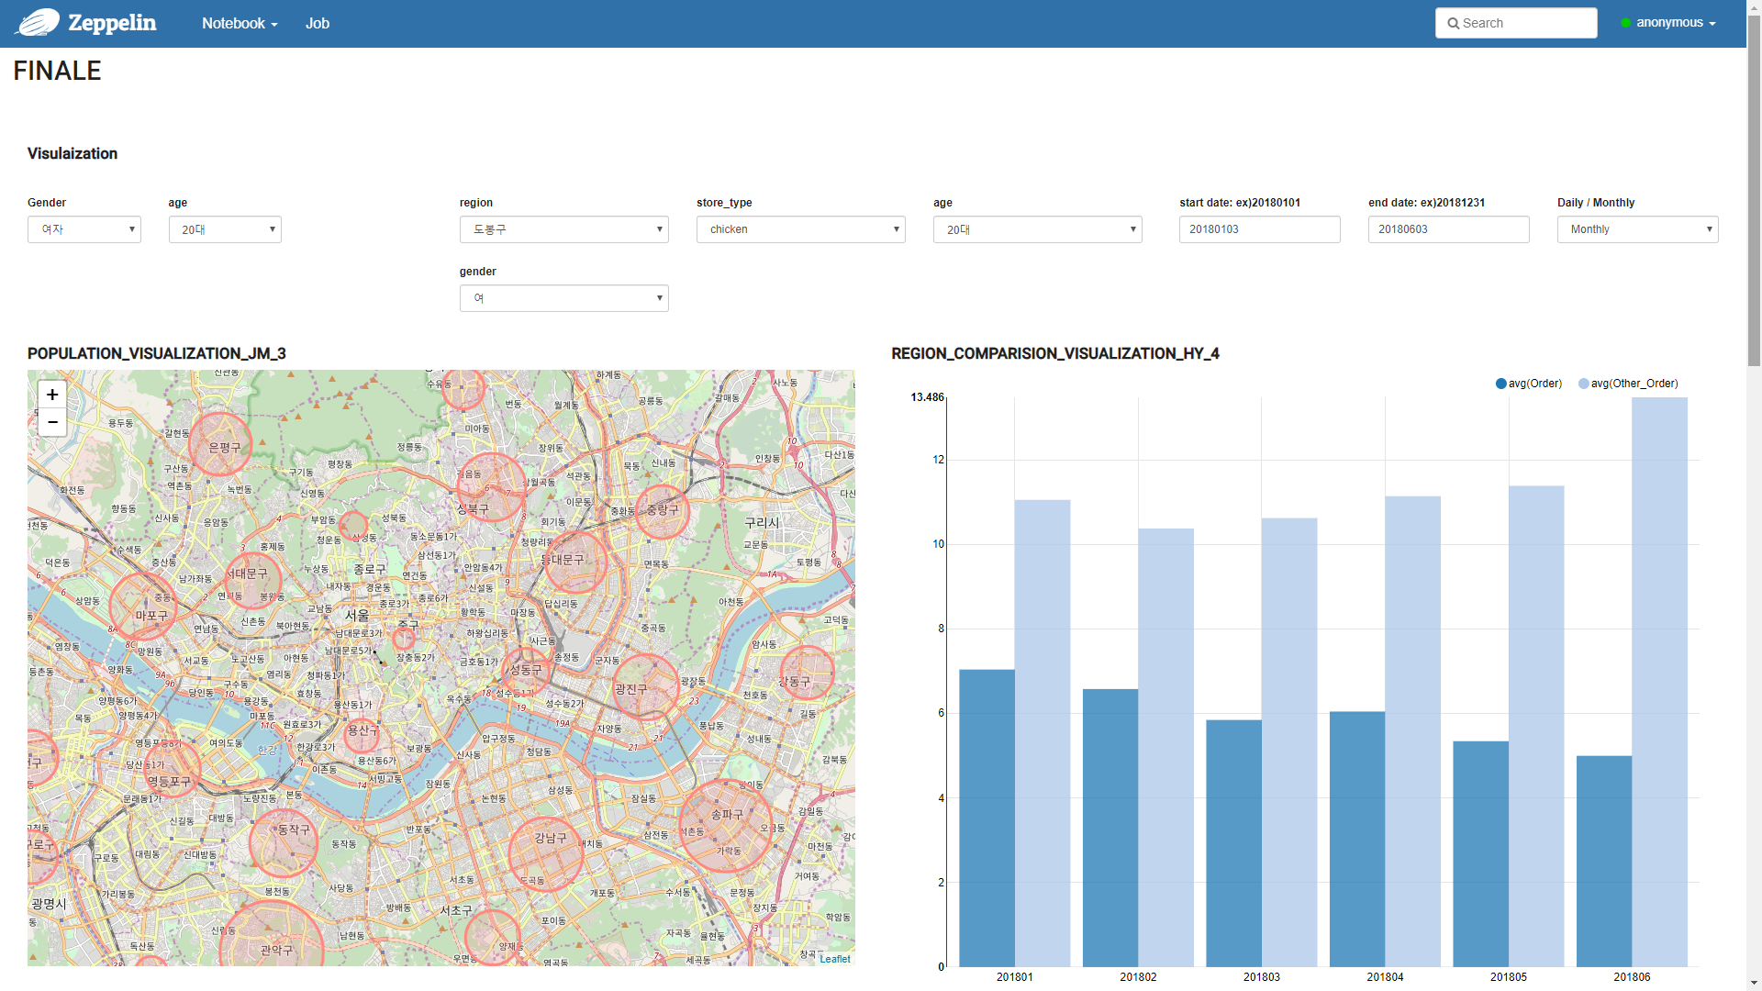
Data Analysis
Market Analysis
Do-Bong Gu
20s Female Population

Slide 39
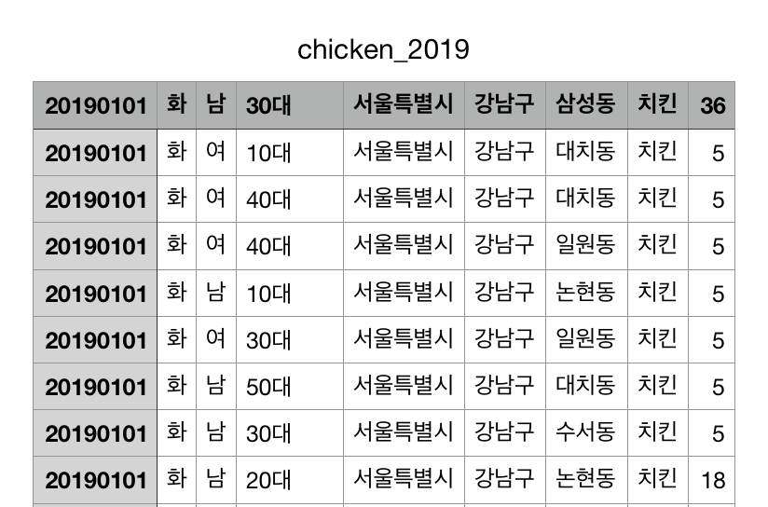
Data Analysis
Market Analysis
20s Female
Chicken Order
Average = ?
Do-Bong Gu
20s Female Population
Gang-Nam, Jong-ro, Do-Bong, Yong-san, Joong

Slide 40
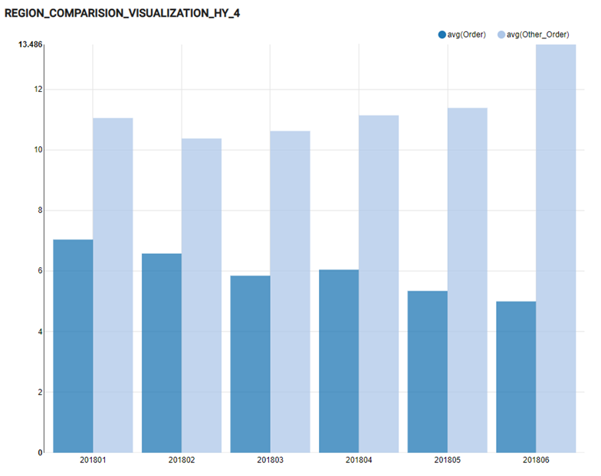

Data Analysis
Market Analysis
20s Female
Chicken Order
Average
Do-Bong Gu
20s Female
Chicken Order

Slide 41
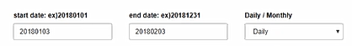
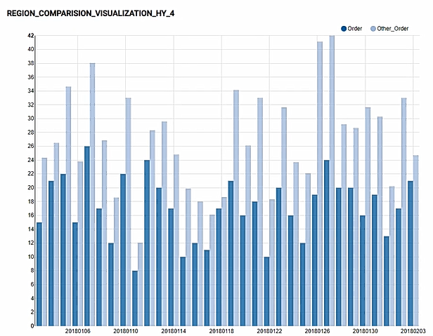
Data Analysis
Market Analysis
20s Female
Chicken Order
Average
Do-Bong Gu
20s Female
Chicken Order

Slide 42
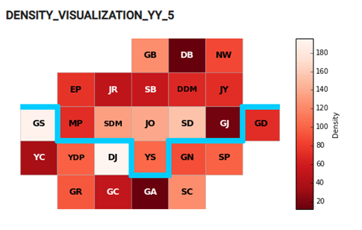
Data Analysis
Market Analysis
Number of Chicken Order
Number of Chicken Store
Red Ocean
Do-Bong Gu is Red Ocean of chicken

Slide 43
Data Analysis
Goal of Analysis
Market Analysis
Successful Marketing strategy
Current consumption pattern analysis

Slide 44
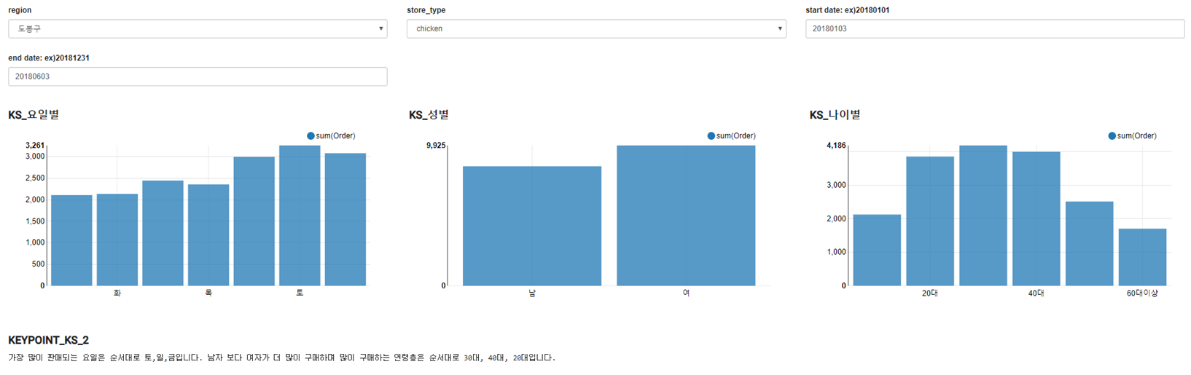
Data Analysis
Consumer Pattern Analysis

Slide 45
Data Analysis
Consumer Pattern Analysis

Slide 46
Data Analysis
Consumer Pattern Analysis

Slide 47
Data Analysis
Consumer Pattern Analysis

Slide 48
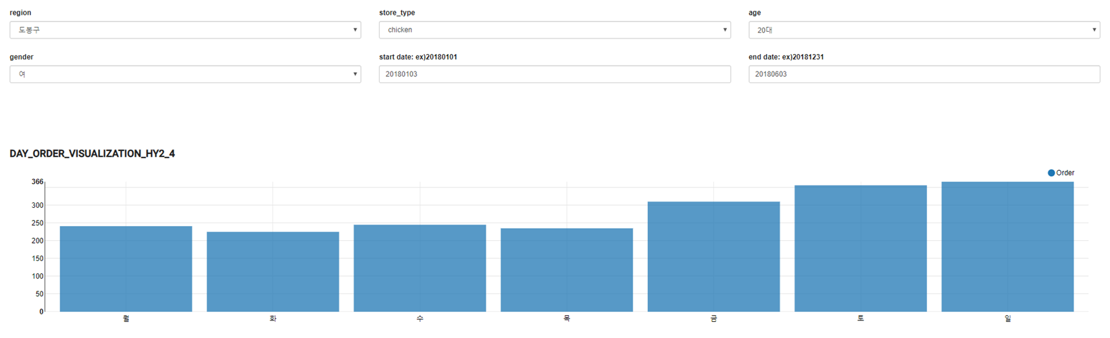
Data Analysis
Consumer Pattern Analysis
=> It is effective to open event for 20s female on weekend

Slide 49
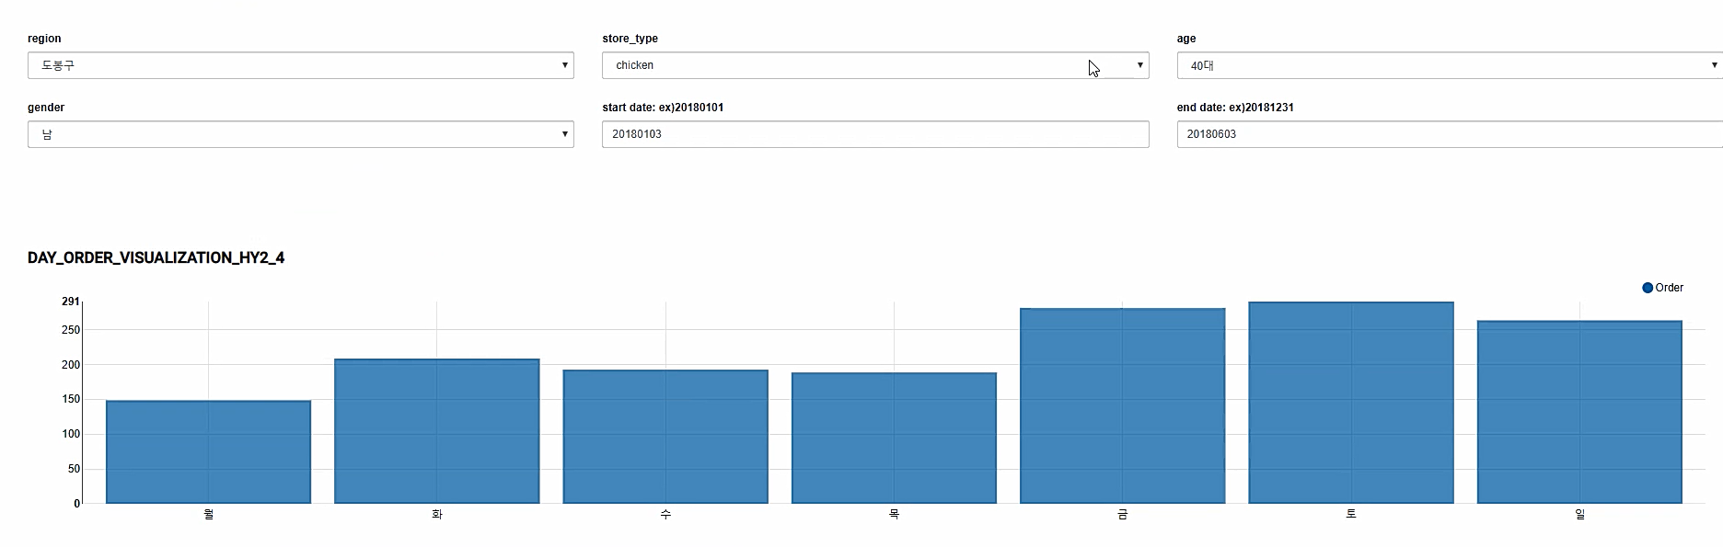
Data Analysis
Consumer Pattern Analysis
=> It is effective to open event for 40s male on Friday and sunday

Slide 50
Optimization

Slide 51
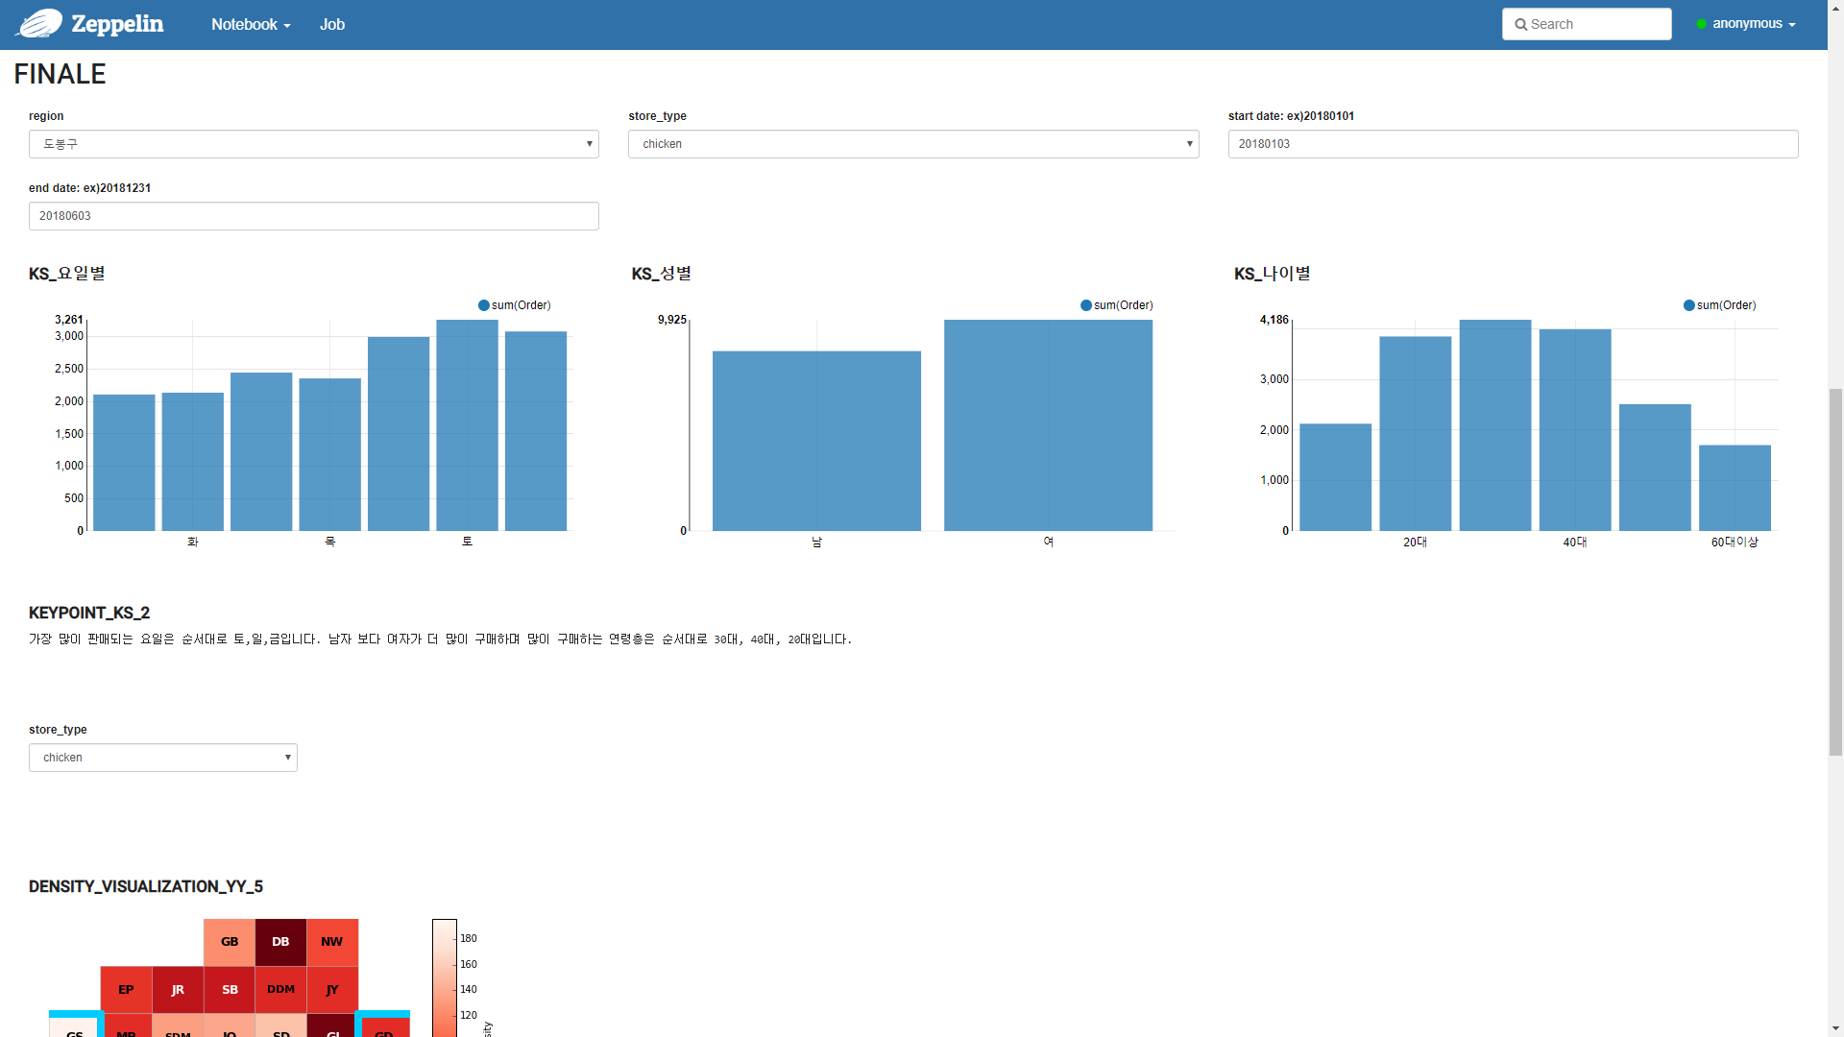
Optimization
Bar Chart

Slide 52

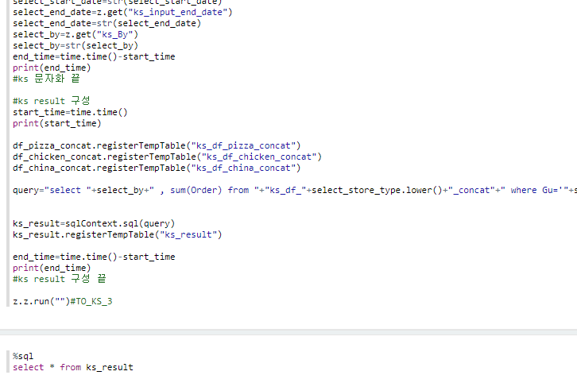
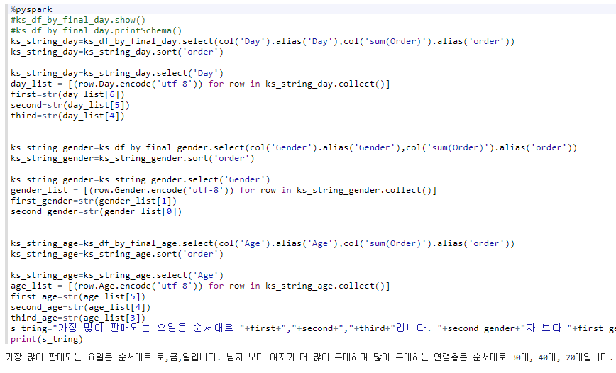
Optimization
Bar Chart
SQL
DataFrame
<
Time: 0.150185108185
Time: 0.113816022873
Notes:
코드는 일부 발췌, 부등호는 빠른 쪽이 더 큼.

Slide 53
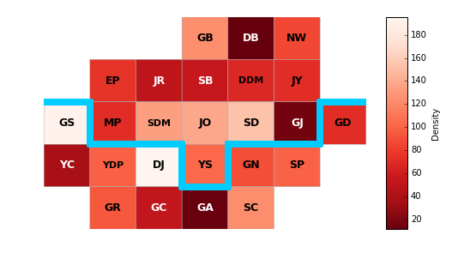
Optimization
Block Map

Slide 54
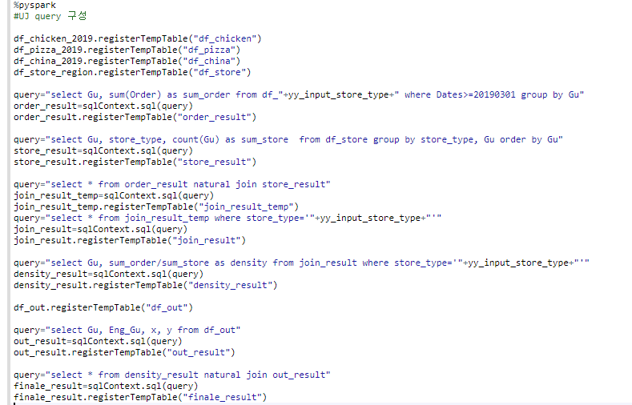
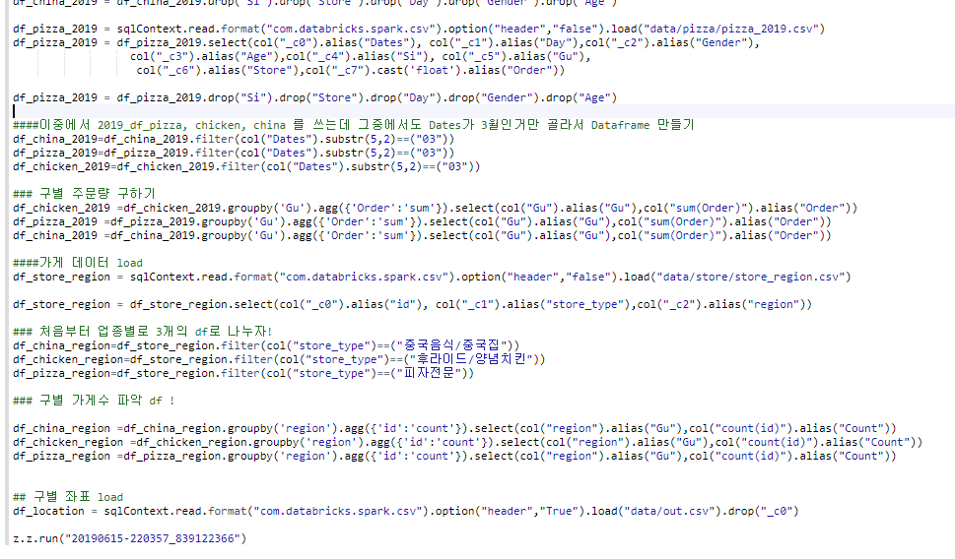
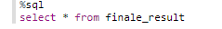
Optimization
Block Map
SQL
DataFrame
>
Time: 0.134809017181
Time: 0.404083013535

Slide 55
Thank You

